Slide 1
Hourly Energy Consumption Forecast (P-562)
Group - IV

Slide 2
Group Members:
Mrinmoy Nanda
NAVEEN NAGAPPA NAGANURI
SHAIKH AKBAR ALI
Bhavana S
Smrithi Radhakrishnan
Boyina Ramyasree
Karthik Muskula
Mentor:

Slide 3
Objective
Project Goal: Analyze and forecast hourly energy consumption for the PJM Interconnection LLC (PJM) region.
Data Source: Hourly power consumption data (in MW) from PJM’s official website, covering multiple U.S. states and regions.
Key Tasks:
Split the last year into a test set and build predictive models.
Identify trends by hour of the day, holidays, and seasonal variations.
Compare daily trends across summer vs. winter.
Forecast energy consumption for the next 30 days.

Slide 4
Dataset details
Source: PJM Interconnection LLC hourly energy consumption data (in MW).
Time Period Covered: April 1, 2002 – August 3, 2018.
Number of Records: 143,206 hourly entries.
Features: datetime - timestamp of energy consumption
PJWM_MW – Energy consumed (in megawatts)
Data Quality: No missing values in the dataset.
Granularity: Hourly observations.

Slide 5
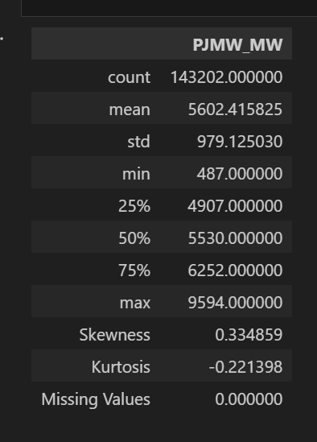
Exploratory Data Analysis
In statistical summary Generated a comprehensive statistical summary table including descriptive stats, skewness, kurtosis, and missing value counts for all features

Slide 6
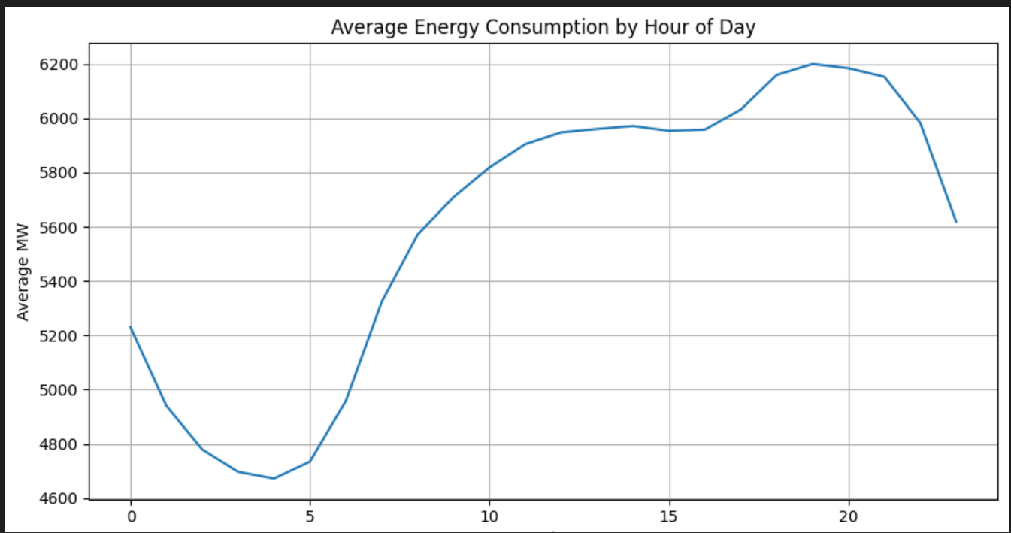
Data Visualization
Analyzed and visualized average hourly energy consumption to identify daily usage patterns.
Nighttime Low – Energy usage is lowest around 4–5 AM (~4,650 MW), likely due to minimal activity during early morning hours.
Morning Surge – Sharp increase starts after 6 AM, peaking above 5,800 MW by late morning as daily routines begin.
Daytime Plateau – Consumption remains steady at ~5,900–6,000 MW from late morning to early evening.
Evening Peak – Maximum demand occurs around
8–9 PM (~6,200 MW), possibly from residential usage
and commercial lighting.
Late-night Decline – After 9 PM, consumption
gradually drops as activity decreases.

Slide 7
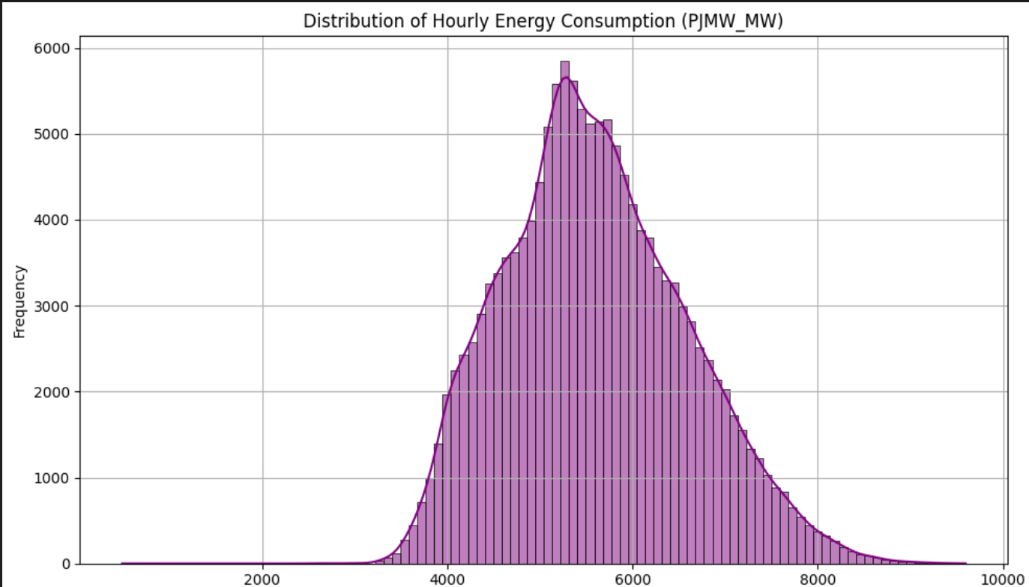
Plotted the distribution of hourly energy consumption to understand data spread and detect skewness.
Peak Consumption – Most hourly energy consumption values cluster around 5,500 MW.
Typical Range – Majority of values lie between 4,000 MW and 7,000 MW.
Slight Right Skew – Occasional high-demand hours push values toward the higher end.
Few Extremes – No significant isolated outliers are visible in the distribution.
Forecasting Impact – Slight skewness may require transformations for some time series models.

Slide 8
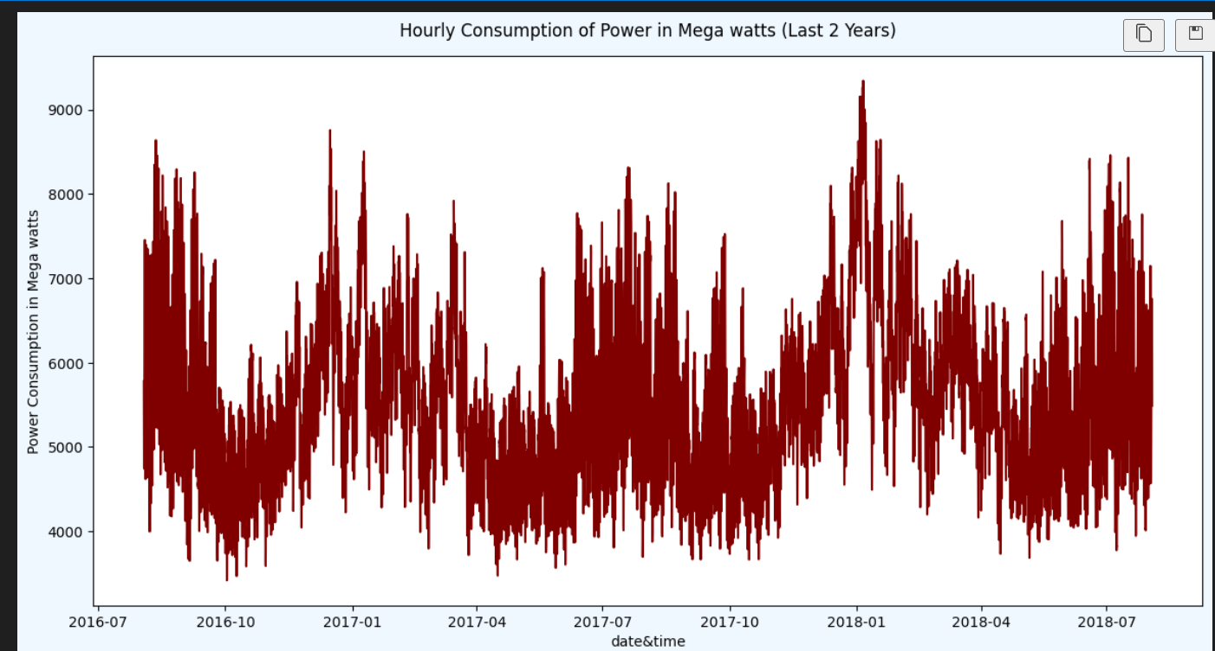
Visualized the last two years of hourly power consumption to identify trends and seasonality patterns
Clear Seasonality – Power consumption
follows a recurring annual cycle, with peaks in
winter and summer months and dips in spring
and fall.
Winter Peaks – Highest demand (~9,200 MW)
occurs during late December–January, likely due
to heating needs.
Summer Peaks – Secondary high demand (~8,500 MW) appears in July–August, likely from cooling systems.
Off-Peak Periods – Lowest consumption (~3,800–4,500 MW) is seen in spring and early autumn, reflecting mild weather and reduced HVAC use.
High Short-Term Fluctuations – Significant hourly variability indicates rapid demand shifts, possibly influenced by work hours, weekends, and special events.

Slide 9
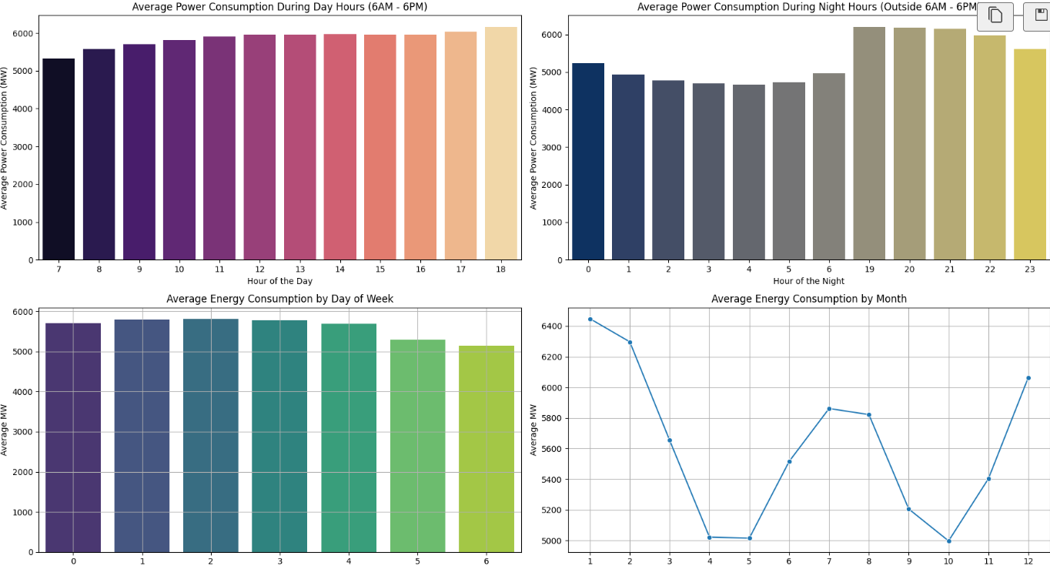
Compared average power consumption across day/night hours, weekdays, and months to reveal daily, weekly, and seasonal usage patterns

Slide 10
Insights
Daytime Demand Rises Gradually – Consumption increases steadily from morning (6 AM) to a peak around 6 PM (~6,200 MW), suggesting work-hour related usage.
Nighttime Peaks in Evenings – After 7 PM, consumption spikes sharply (~6,200 MW), likely due to residential lighting, cooking, and entertainment, before dipping past midnight.
Weekday vs Weekend Gap – Early weekdays (Mon–Thu) have higher usage (~5,800–5,900 MW) than weekends (~5,100–5,300 MW), reflecting reduced industrial and office activity.
Seasonal Variations – Consumption peaks in January and December (>6,200 MW), dips in April–May (~5,000 MW), and rises again in July–August (~5,900 MW), indicating winter heating and summer cooling demand.
Lowest Seasonal Demand – The sharpest trough occurs in October (~5,000 MW), aligning with mild weather and minimal HVAC load.

Slide 11
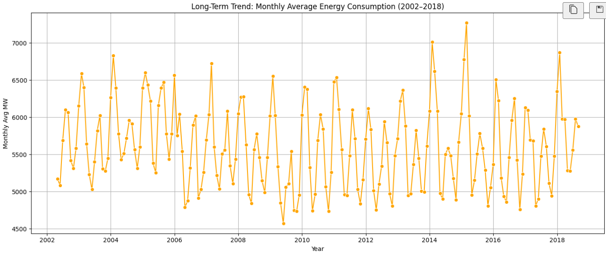
Resampled data to monthly averages to visualize long-term energy consumption trends from 2002–2018
Highly Seasonal Pattern – Peaks and troughs repeat each year, indicating strong seasonal demand cycles (likely winter heating and summer cooling).
Sharp Short-Term Spikes – Several years (e.g., 2004, 2011, 2015) have sudden monthly spikes above 7,000 MW, suggesting extreme weather or unusual demand surges.
Mid-Period Dip – Between 2007–2013, there’s a noticeable drop in peaks and more frequent troughs near 4,600–4,800 MW, hinting at economic or operational slowdowns.
Post-2014 Recovery – After 2014, peaks become more pronounced again, occasionally surpassing earlier highs.
No Strong Upward Trend – While fluctuations are large, the baseline average remains around 5,500–6,000 MW, showing stable long-term consumption without sustained growth.

Slide 12
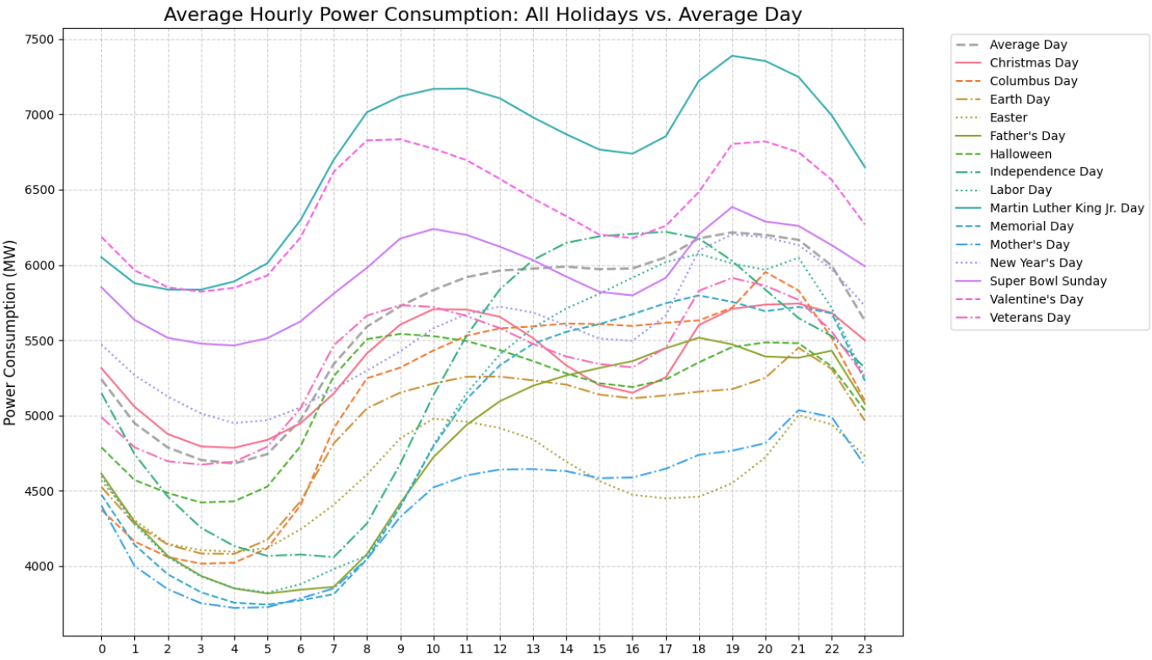
Compared hourly power consumption patterns on various holidays against average days to highlight demand variations Major holidays like Christmas and New Year's Day show significantly lower consumption, especially during morning and evening peaks, reflecting reduced industrial activity and altered residential behavior. Super Bowl Sunday exhibits a sharp evening spike, likely due to increased residential usage during game time (TVs, cooking, lighting). Weekday holidays such as Labor Day and Columbus Day closely resemble average day patterns, suggesting minimal disruption to routine energy demand. Independence Day shows a midday dip followed by a mild evening rise, possibly due to outdoor celebrations shifting energy use away from homes. Mother’s Day and Father’s Day align closely with average consumption, indicating these holidays have minimal impact on overall power usage.

Slide 13
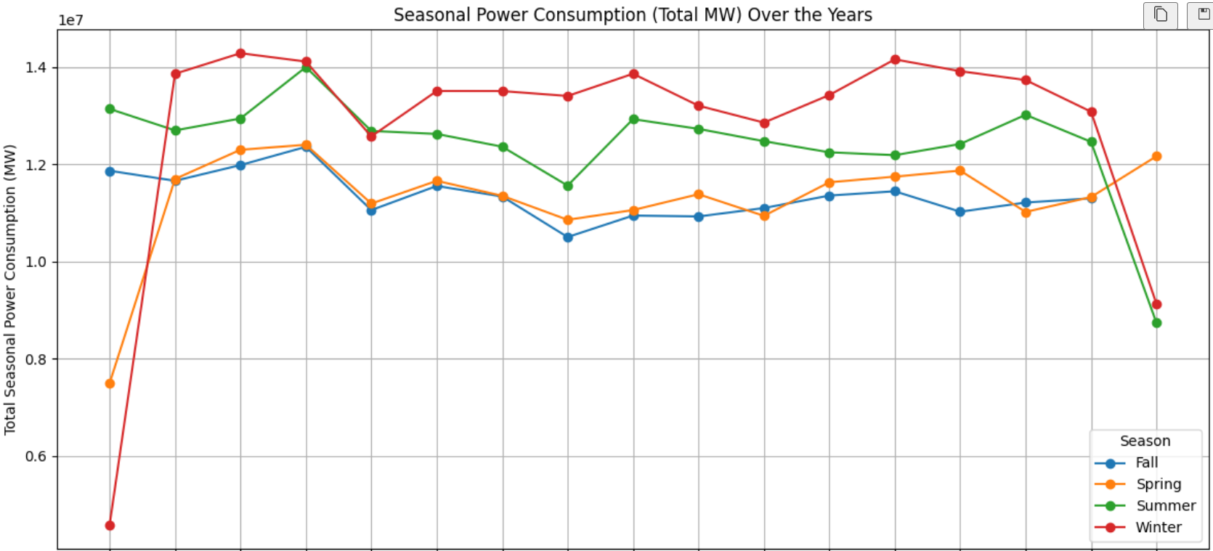
Plotted seasonal power consumption trends over the years to capture seasonal demand fluctuations

Slide 14
Insights
Winter consistently shows the highest power consumption, likely due to heating demands and longer periods of indoor activity.
Summer ranks second in consumption, driven by cooling needs such as air conditioning, especially during peak heat periods.
Spring and Fall exhibit lower and more stable consumption, reflecting milder temperatures and reduced HVAC usage.
Seasonal fluctuations vary year to year, indicating the influence of external factors like weather anomalies, population growth, or policy changes.
Understanding these trends is crucial for grid planning, helping utilities anticipate seasonal load shifts and optimize energy distribution strategies.

Slide 15
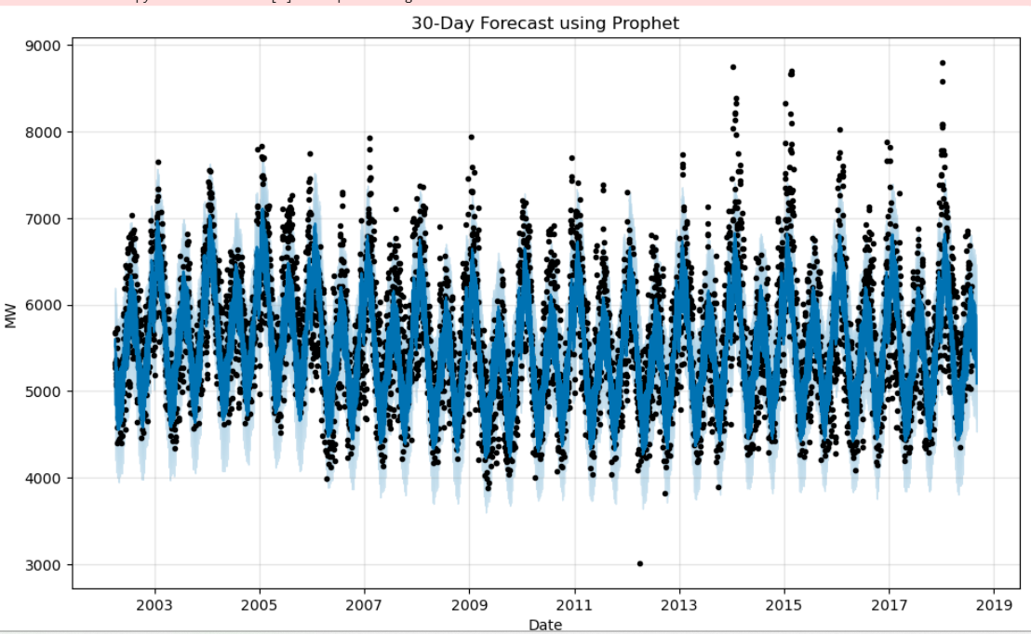
Model building- Deep learning models
1. Prophet model

Slide 16
Strong seasonal patterns:
- The model captures a repeating annual cycle (like summer and winter peaks, spring and autumn troughs)
- This is visible in the sharp periodic spikes every year — typical for electricity demand driven by heating/cooling needs
Reasonable fit to historical data:
- The blue line (Prophet's fitted trend + seasonality) closely follows the black dots (actual data)
Long-term stability in the trend:
- No major upward or downward drift over 2002–2019 — the long-term demand appears relatively stable, oscillating around 5000–7000 MW.

Slide 17
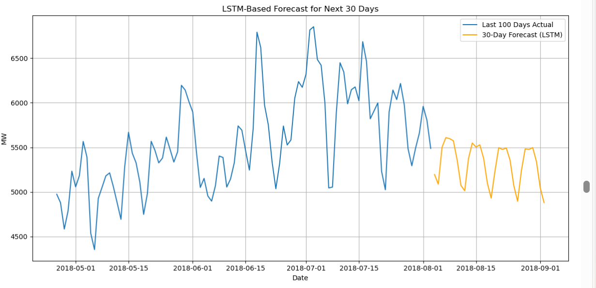
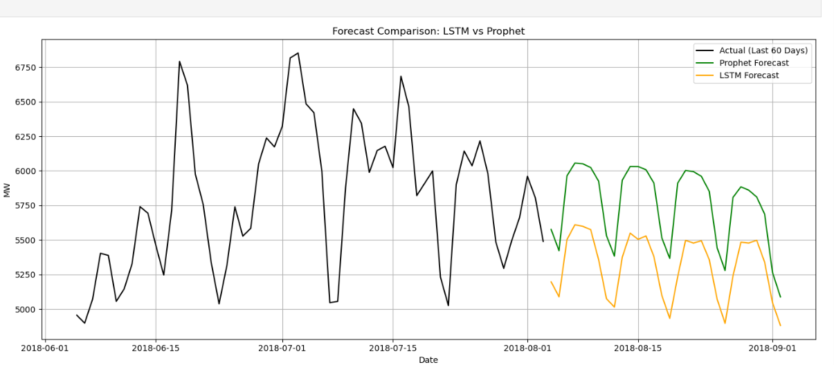
2. LSTM model
LSTM Vs Prophet model comparison

Slide 18
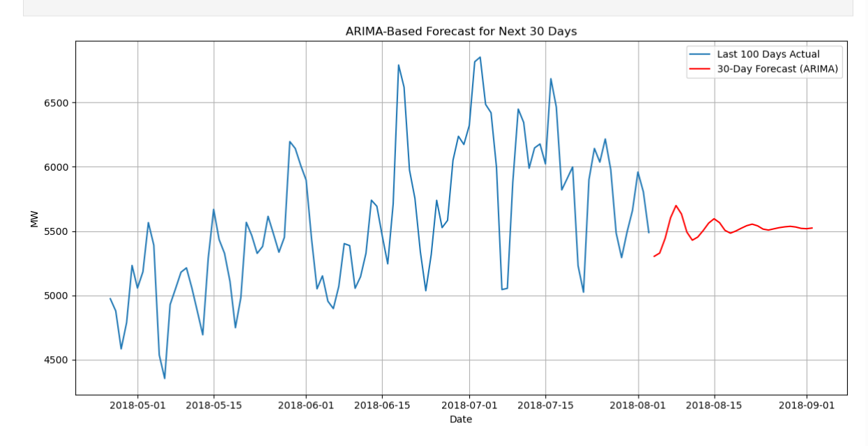
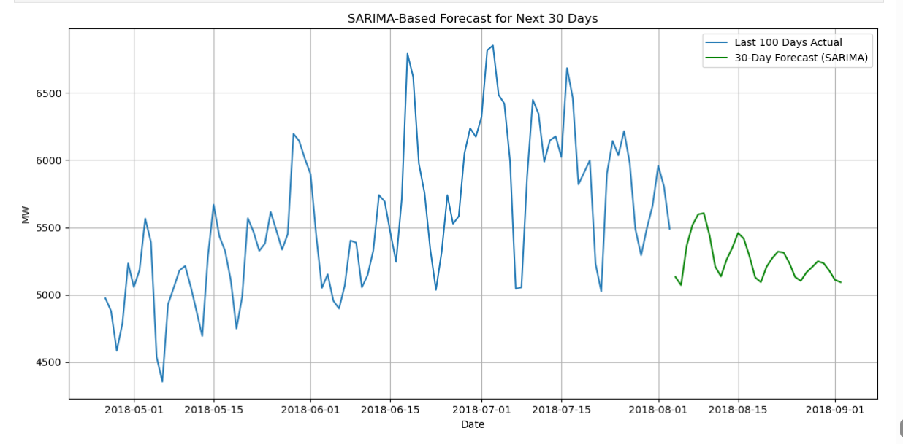
3. ARIMA model
Time series models
4. SARIMA model

Slide 19
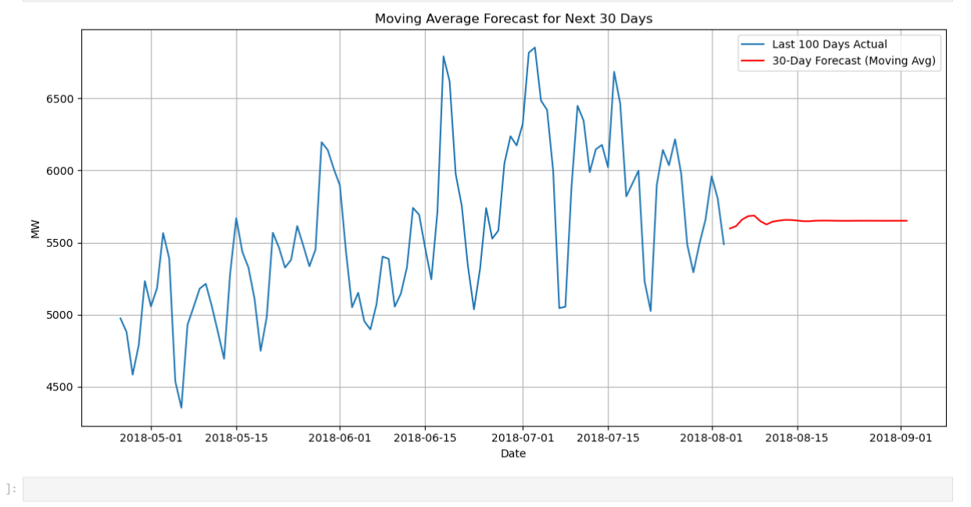
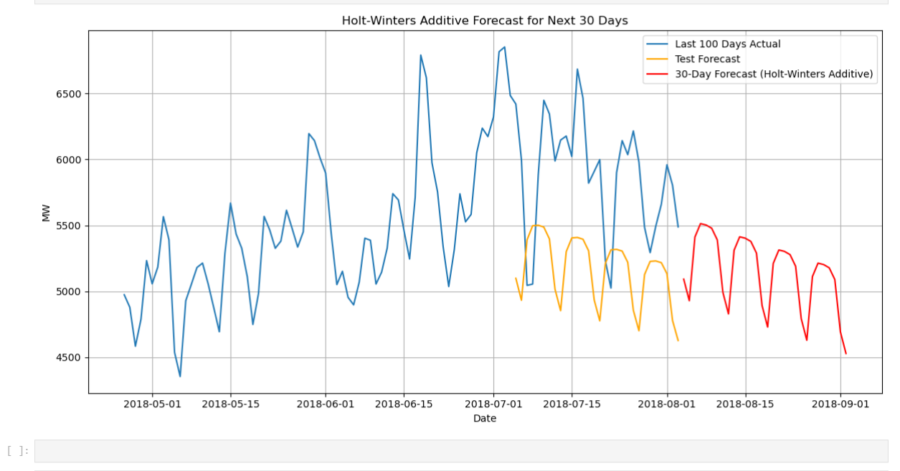
5. Moving average method
6. Holt-Winters additive method

Slide 20
Model evaluation
Moving Average RMSE: 461.71, MAE: 363.57
Prophet RMSE: 549.09, MAE: 476.38
ARIMA RMSE: 758.45, MAE: 644.18
LSTM RMSE: 755.43, MAE: 669.87
SARIMA RMSE: 750.84, MAE: 675.63
Holt-Winters Additive RMSE: 866.59, MAE: 776.25

Slide 21
Model selection for deployment - LSTM
Even if RMSE/MAE is slightly worse in historical testing, the LSTM can perform better when new unseen patterns appear in the future, especially if the time series could become more complex
Generalization capability- LSTM models are better at learning temporal dependencies and adapting to changes in patterns over time
Traditional models like MA or ARIMA can degrade in accuracy when forecasting far ahead, whereas LSTM can maintain reasonable performance over longer forecast horizons

Slide 22
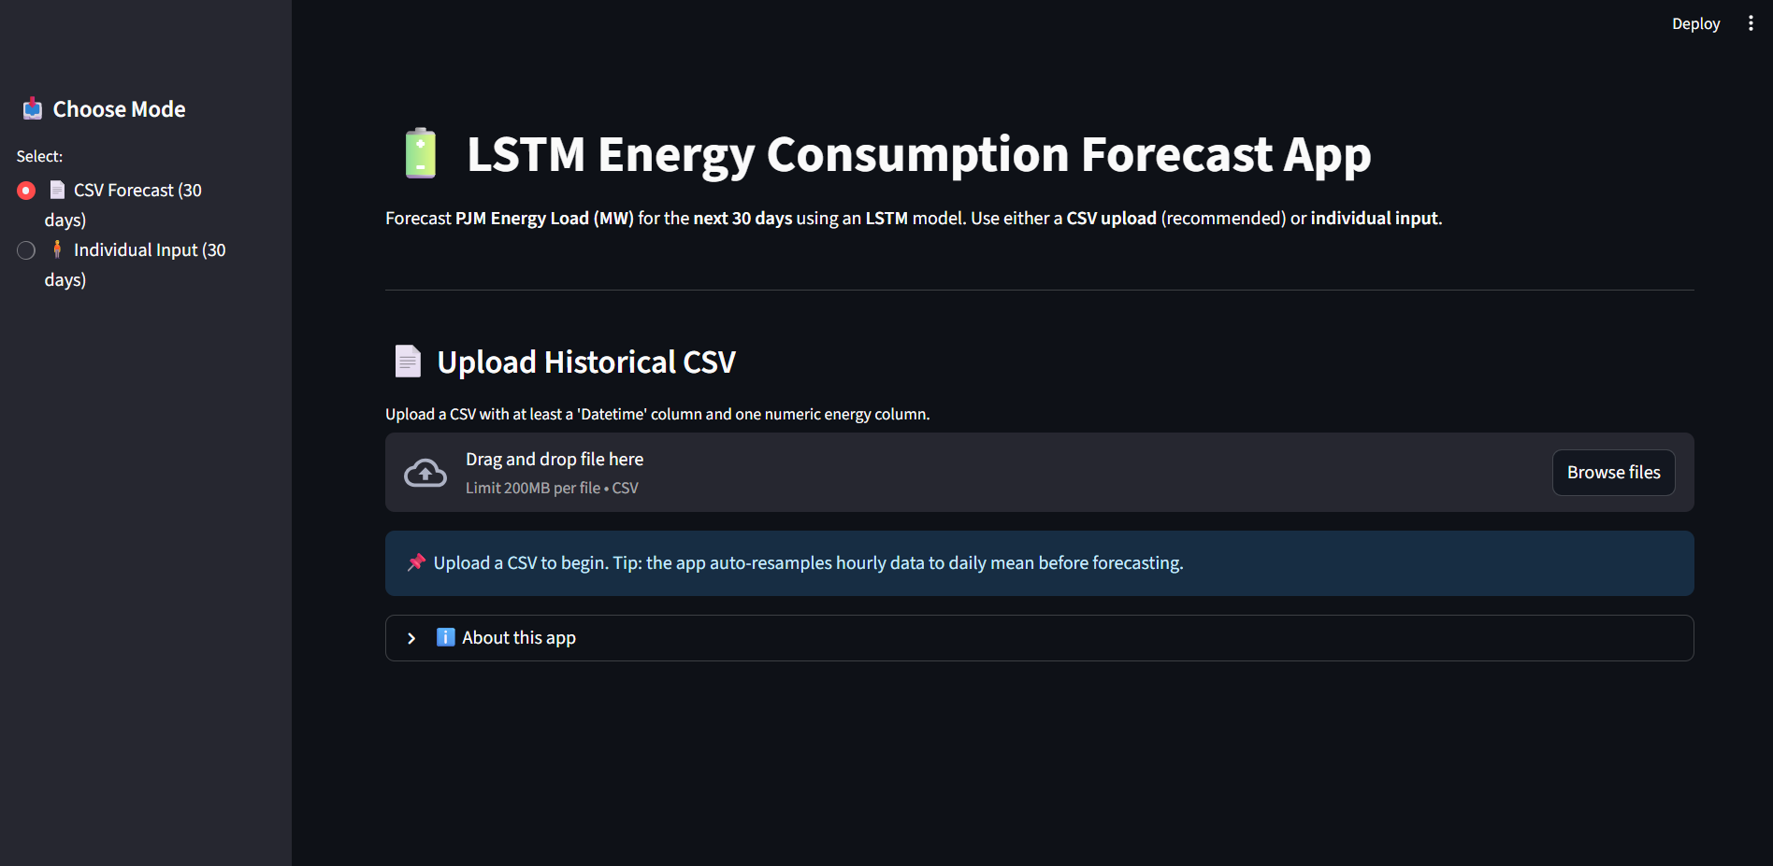
Deployment using Streamlit

Slide 23
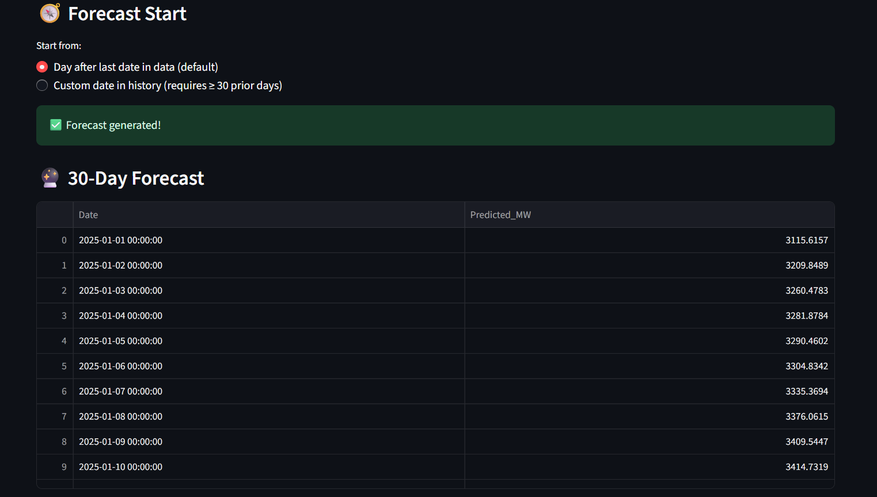

Slide 24
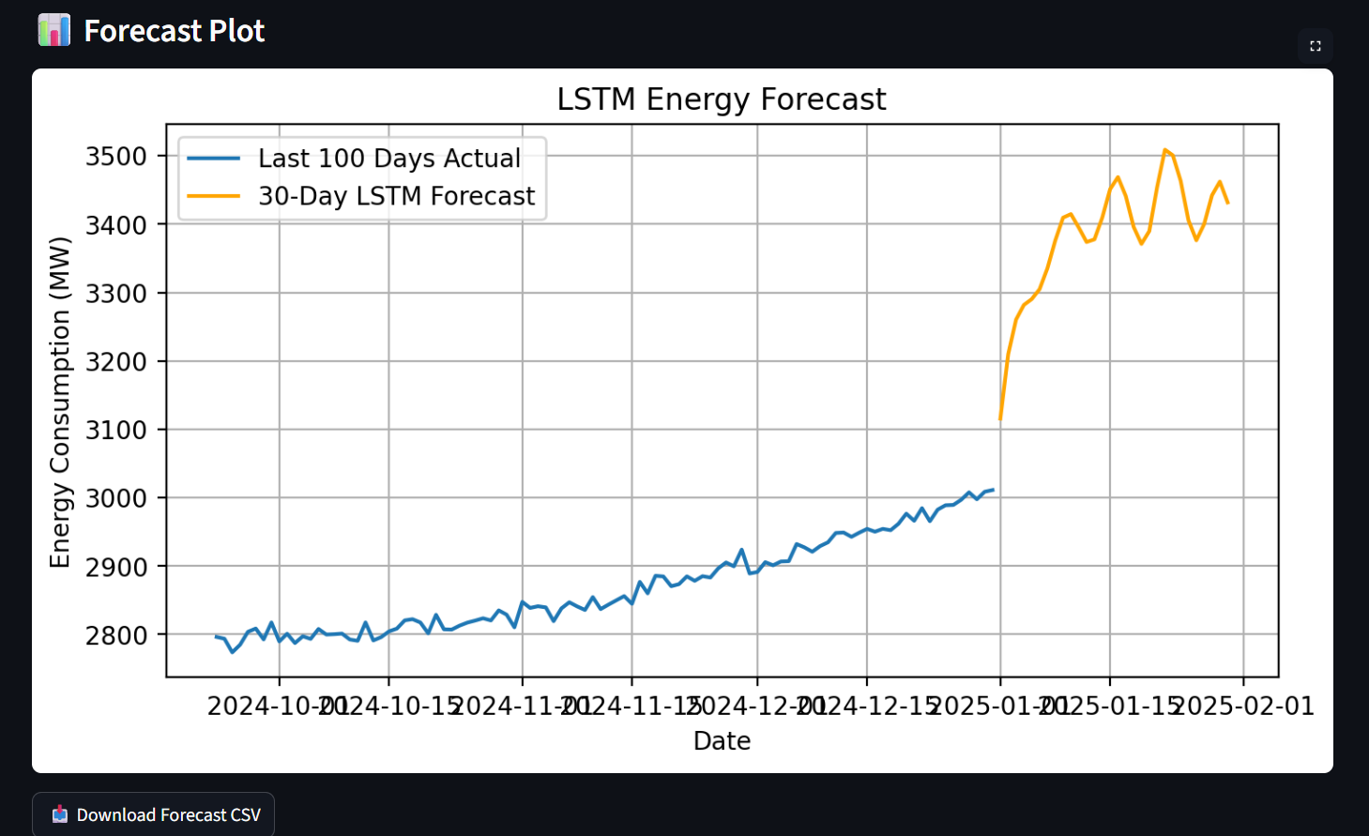

Slide 25
Challenges faced
Challenge: Handling strong seasonality and trends in the data.
Solution: Applied seasonal decomposition and used models that explicitly account for seasonality (Holt-Winters, SARIMA, Prophet).
Challenge: Selecting optimal parameters for each model.
Solution: Used auto-ARIMA for ARIMA and SARIMA models and experimented with hyperparameters to improve accuracy.
Model Convergence Issues
Challenge: Holt-Winters and SARIMA sometimes failed to converge due to poor initial parameter estimates.
Solution: Tried multiple initialization strategies and manually adjusted starting parameters.

Slide 26
Conclusion
Moving Average surprisingly performed the best in both RMSE and MAE, meaning its simplicity worked well for this dataset
Prophet was the second-best, showing good seasonal capture and low errors
Holt-Winters performed the worst in this case, possibly due to its additive seasonality not matching the real data’s behavior

Slide 27
Thank you
Thank you for your time and attention! We look forward to your feedback and suggestions.

